Slide 1
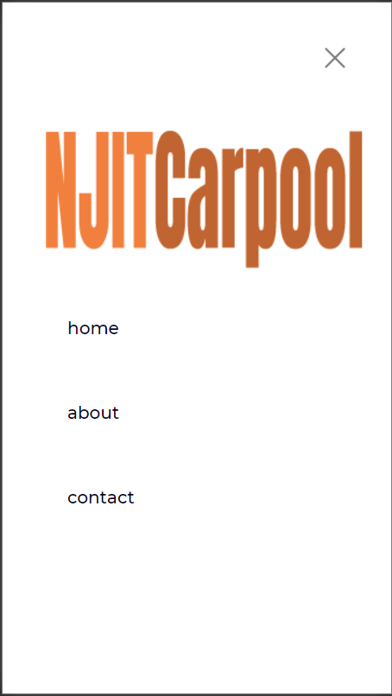
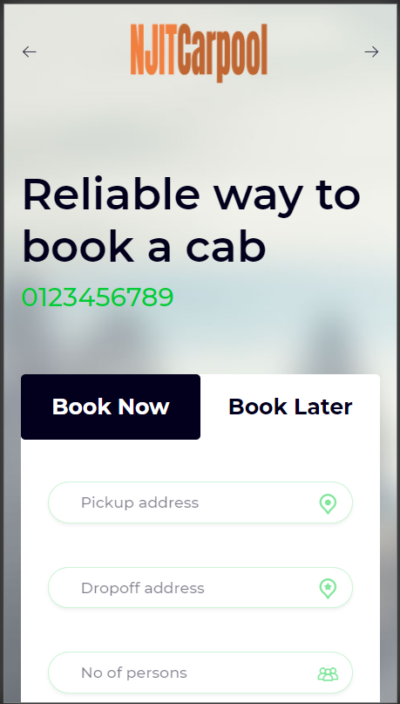
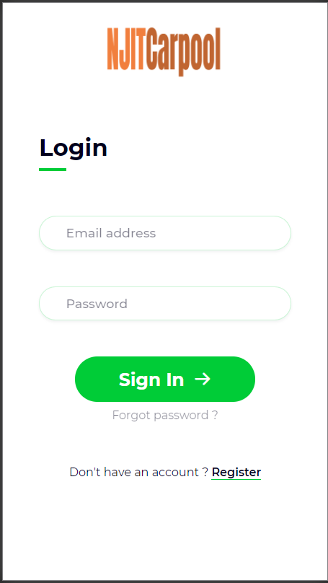
Carpool App
Group 1
Kevin Anton,
Soumik Chaudhuri,
Kefin Sajan

Slide 2
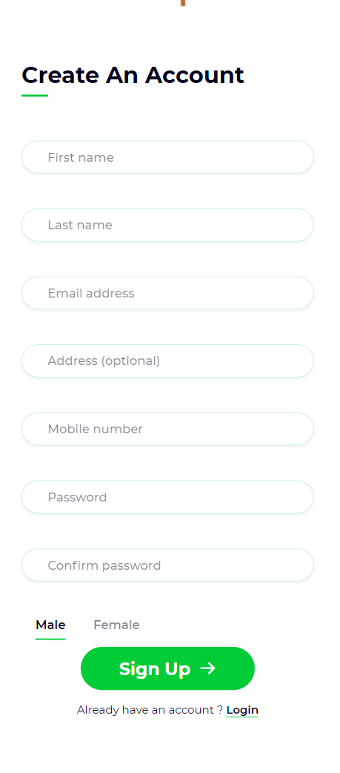
About
Our objective is to allow NJIT students to exchange information and schedule a carpool to/from NJIT. We hope to connect people through their smartphones to each other.By introducing this application to the students at NJIT, we aim to play a part in reducing pollution, saving students on commute costs, and reducing traffic on our roads.

Slide 3
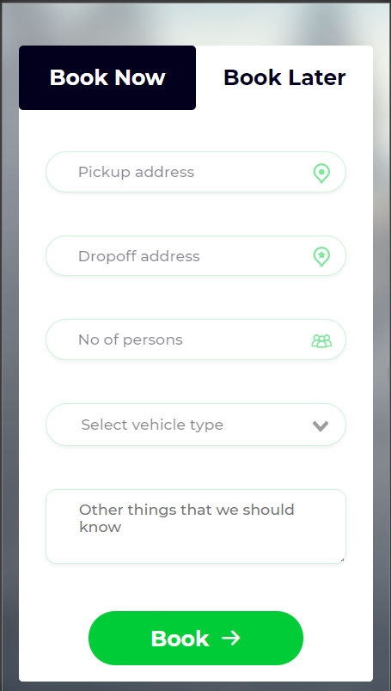
What we used?
This application is built on a applet supported by Hermit Lite Apps Browser. Hermit converts web sites into lite apps that are tightly integrated with Android. One of Hermit’s claims is that it can create an app based off of any website.

Slide 4
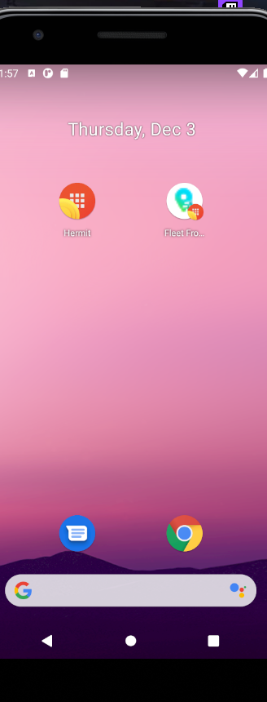
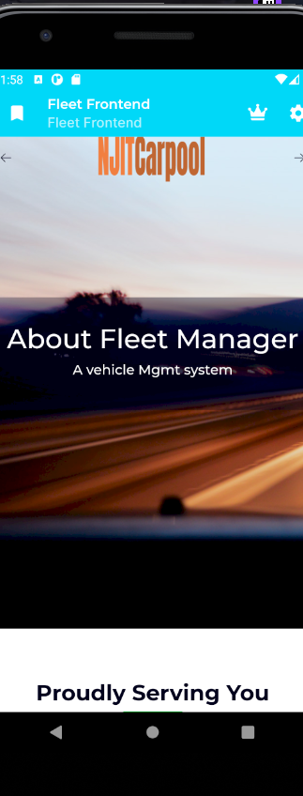
Hermit
Lite apps browser
Allows us to convert a website into a portable lite app that can be accessed from the home screen of an android device
Simple conversion with immediate results

Slide 5
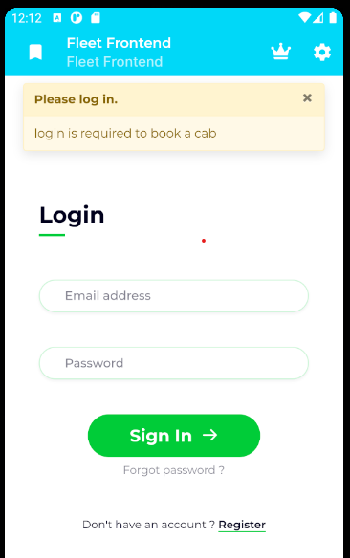
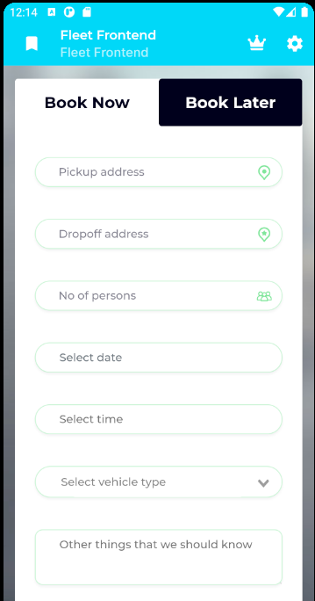
App
Features
Login
Car Viewer
User testimonials
Useful contact links
Options to book now or later
Account required to book a cab

Slide 6
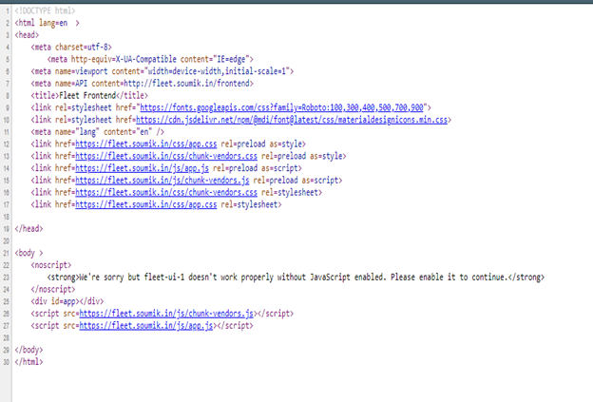
App Internals
Main Language: HTML, PHP, CSS

Slide 7
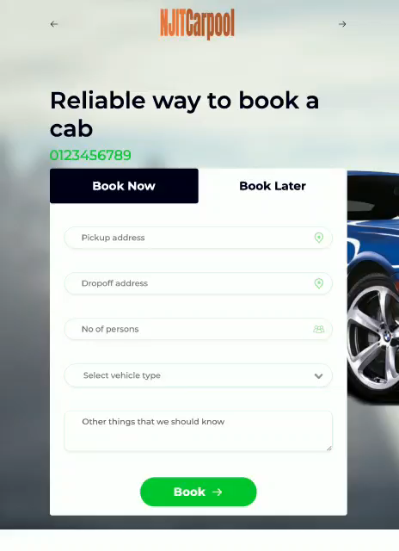
DEMO

Slide 8
Thank you!
Kevin Anton,
Soumik Chaudhuri,
Kefin Sajan
Carpool App
Group 1

